Slide 1
Computer Architecture I
CS-GY-6133
Topic: Single Cycle MIPS Implementation
Instructor: Siddharth Garg

Slide 2
MIPS Instructions: R-Type
31
26
25
21
20
16
15
11
10
6
5
0
Op-code
(6-bits)
Rs
(5-bits)
Rt
(5-bits)
Rd
(5-bits)
Shamt
(5-bits)
funct
(6-bits)
000000 for all R-type instructions
Operand register identifiers
Result register identifier
Shift amount
Add: 100000 = 20_{hex}
Sub: 100010 = 22_{hex}
Or: 100101 = 25_{hex}
Sll: 000000 = 00_{hex}
add rs, rt, rd // R[rd] ← R[rs] + R[rd]; signed addition; trap on overflow
sub rs, rt, rd // R[rd] ← R[rs] - R[rt]; signed subtraction; trap on overflow
or rs, rt, rd // R[rd] ← R[rs] | R[rt]; bit-wise Boolean OR operation
sll rt, rd, shamt // R[rd] ← R[rt] << shamt; logical shift left
…..(many others)

Slide 3
MIPS Instructions: I-Type
31
26
25
21
20
16
15
0
Op-code
(6-bits)
Rs
(5-bits)
Rt
(5-bits)
Immediate
(16-bits)
addi: 8_{hex}
beq: 4_{hex}
ori: 25_{hex}
lw: 23_{hex}
Operand register
Result register
Immediate operand
(“PC relative”)
addi rs, rt, imm // R[rt] ← R[rs] + {SignExtend, imm}; MSB of imm is extended to 32 bits
beq rs, rt, imm // if{R[rs] == R[rt]} branch to PC + 4 + Target; (“PC relative”)
ori rs, rt, imm // R[rt] ← R[rs] | {ZeroExtend,imm}; bit-wise Boolean OR operation
lw rs, rt, imm // R[rt] ← Mem[ {SignExtendimm} + R[rs] ] (“Displaced/based”)
…..(many others)

Slide 4
MIPS Instructions: J-Type
31
26
25
0
Op-code
(6-bits)
address
(26-bits)
j: 2_{hex}
jal: 3_{hex}
Immediate operand
j address // PC ← {PC+4[31:28], address, 00}

Slide 5
Implementation of the MIPS ISA
DATA
ADDRESS
0000 0000
00000
Hardware building blocks
00001
A21F FFB3
FFFF FFFF
00010
BB33 CD53
.
00011
1242 221E
5 bit address
.
Rd Reg. 1
Read
Data 1
32 bit data
5 bit address
0001 0001
11111
Rd Reg. 2
5 bit address
32 bit data
Wrt Reg.
Read
Data 2
00001
Rd Reg. 1
PC
32 bit data
00010
Read
Data 1
Wrt Data
FFFF FFFF
A21F FFB3
11111
Rd Reg. 2
Program Counter
A 32-bit “register”
(can store information)
Wrt Enable
00010
Wrt Reg.
Read
Data 2
0001 0001
Set to ‘1’ to enable write
FFFF FFFF
Wrt Data
Register File
32 32-bit registers
(2 Read ports, 1 Write Port)
Wrt Enable
0
1

Slide 6
Arithmetic Logic Unit
31
26
25
21
20
16
15
11
10
6
5
0
Op-code
(6-bits)
Rs
(5-bits)
Rt
(5-bits)
Rd
(5-bits)
Shamt
(5-bits)
funct
(6-bits)
000000 for all R-type instructions
Operand register identifiers
Result register identifier
Shift amount
Add: 20_{hex}
Addu: 21_{hex}
Sub: 22_{hex}
Subu: 23_{hex}
And: 24_{hex}
Or: 25_{hx}
Nor: 27_{hex}
Arithmetic/Logic Unit (ALU)
ALU op
NOTE: Updated funct values
? bits
3
In-Class Problem 1: how do we set the bits of ALUop?
32 bits
oprnd1
32 bits
result
Inst[2:0] decides which operation the ALU performs.
32 bits
oprnd2

Slide 7
Implementation of the MIPS ISA
Hardware building blocks
Is this a von Neumann architecture?
Read Mem
32 bits
Set to ‘1’ to enable read; 0 otherwise
32 bits
Address
Read Address
32 bits
Instruction
32 bits
Write
Data
32 bits
Read Data
Set to ‘1’ to enable write; 0 otherwise
Data Memory
Instruction Memory
(Read only)
Write Mem
Data Memory
(Either read or write, but not both together)

Slide 8
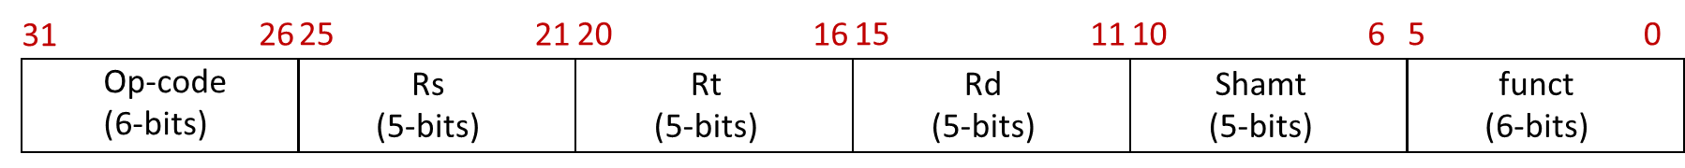
R-Type ALU Instructions
Adder
+4
ALU op
PC
Read Address
25:21
3
Rd Reg. 1
Read
Data 1
20:16
Instruction
Rd Reg. 2
ALU
result
15:11
Instruction Memory
Wrt Reg.
Read
Data 2
Wrt Data
Wrt Enable
“Datapath”
1

Slide 9
Example: Instruction at PC=0
4
Adder
+4
000000
00001
00010
00011
00000
010100
4
ALU op
0
PC
Read Address
00001
3
25:21
Rd Reg. 1
Read
Data 1
A21F FFB3
00010
20:16
Instruction
Rd Reg. 2
00011
ALU
result
15:11
BB33 CD53
Instruction Memory
Wrt Reg.
Read
Data 2
RF Contents
Wrt Data
0000 0000
00000
A21F FFB3
00001
Wrt Enable
BB33 CD53
00010
0
.
00011
1
1242 221E
.
A21F FFB3 | BB33 CD53
0001 0001
11111

Slide 10
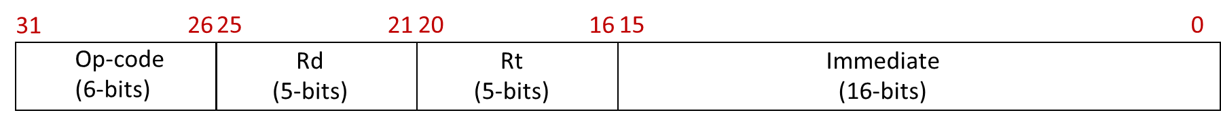
I-Type ALU Instructions
Adder
+4
ALU op
PC
Read Address
25:21
3
Rd Reg. 1
Read
Data 1
20:16
Instruction
Rd Reg. 2
20:16
ALU
result
15:11
Instruction Memory
Wrt Reg.
Read
Data 2
Wrt Data
15:0
Wrt Enable
32
1
Sign
Extend

Slide 11
Combined R-Type and
I-Type ALU Instructions
Adder
+4
ALU op
PC
Read Address
25:21
3
Rd Reg. 1
Read
Data 1
20:16
Instruction
Rd Reg. 2
ALU
result
Instruction Memory
15:11
Wrt Reg.
Read
Data 2
Wrt Data
I-Type?
a
Wrt Enable
a if (control = 1)
b if (control = 0)
1
I-Type?
MUX
15:0
Sign
Extend
b
control

Slide 12
Combined R-Type and
I-Type ALU Instructions
What about ALUop?
http://www-inst.eecs.berkeley.edu/~cs61c/resources/MIPS_Green_Sheet.pdf
ALU op
3
Add: 20_{hex}
Addu: 21_{hex}
Sub: 22_{hex}
Subu: 23_{hex}
And: 24_{hex}
Or: 25_{hx}
Nor: 27_{hex}
Addi: 8_{hex}
Addiu: 9_{hex}
Andi: c_{hex}
Ori: d_{hx}
ALU
result
Function Field
OpCode

Slide 13
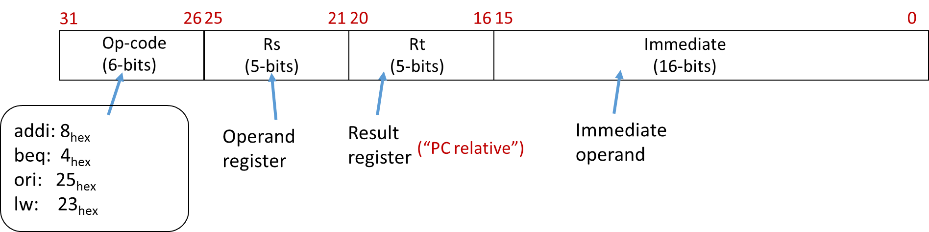
I-Type Load
Instructions
ALUOp = ?
25:21
3
Rd Reg. 1
Read
Data 1
Read Mem
Instruction
20:16
Rd Reg. 2
Instruction Fetch Part Not Shown
ALU
result
Address
15:11
Wrt Reg.
Read
Data 2
Wrt Data
I-Type?
Write
Data
Wrt Enable
Read Data
1
I-Type?
15:0
Sign
Extend
Data Memory
Write Mem

Slide 14
I-Type Load
Instructions
ALUOp = 001
25:21
3
IsLoad?
Rd Reg. 1
Read
Data 1
Read Mem
Instruction
20:16
Rd Reg. 2
ALU
result
Address
Instruction Fetch Part Not Shown
Wrt Reg.
Read
Data 2
15:11
Wrt Data
I-Type?
Write
Data
Wrt Enable
Read Data
1
I-Type?
15:0
Sign
Extend
Data Memory
Write Mem
0
IsLoad?

Slide 15
I-Type Store Instructions
sw rs, rt, imm //M[R[rs]+SignExtendimm] ← R[rt]
ALUOp = 001
25:21
3
isLoad?
Rd Reg. 1
Read
Data 1
Read Mem
Instruction
20:16
Rd Reg. 2
ALU
result
Address
Instruction Fetch Part Not Shown
Wrt Reg.
Read
Data 2
15:11
Wrt Data
I-Type?
Write
Data
Wrt Enable
Read Data
0
1
I-Type?
15:0
Sign
Extend
Data Memory
Write Mem
isStore?
In-Class Problem 2:
Did we miss something?
IsLoad?

Slide 16
Final Data-Path
(Excluding Control Flow Instructions)
ALUOp = 001
25:21
3
isLoad?
Rd Reg. 1
Read
Data 1
Read Mem
Instruction
20:16
Rd Reg. 2
ALU
result
Address
Instruction Fetch Part Not Shown
Wrt Reg.
Read
Data 2
15:11
Wrt Data
I-Type?
Write
Data
Wrt Enable
Read Data
!(IsStore?)
I-Type?
15:0
Sign
Extend
Data Memory
Write Mem
isStore?
IsLoad?

Slide 17
Control Flow
J-Type Control Flow
4 MSB bits taken from the 4 MSBs of PC+4
Next 26 bits taken from the “address” field
Last 2 bits are set to zero? (why?)
31
26
25
0
Op-code
(6-bits)
address
(26-bits)
j address // PC ← {PC+4[31:28], address, 00}, opcode=2_{hex}

Slide 18
J-Type Control Instruction
J-Type?
31:28
Concat
PC+4
00
Adder
+4
25:21
RF Onwards Not Shown
Rd Reg. 1
Read
Data 1
25:0
20:16
Rd Reg. 2
PC
Read Address
15:11
Wrt Reg.
Read
Data 2
Wrt Data
Instruction
I-Type?
Instruction Memory
Wrt Enable
What about WrtEnable?
!(J-Type?)
!(IsStore?)
0
15:0

Slide 19
Control Flow
I-Type Branch Instruction
First 30 MSBs from sign extended immediate
2 LSBs are always 0
31
26
25
21
20
16
15
0
Op-code
(6-bits)
Rs
(5-bits)
Rt
(5-bits)
Immediate
(16-bits)
beq rs, rt, imm // If (R[rs]==R[rt])
// PC ← PC + 4 + {SignExtendImm, 00},
// else
// PC ← PC + 4
// opcode=4_{hex}

Slide 20
NextPC? = function(J-Type?, IsBranch?, IsEq?)
3:1 MUX
PC+4
31:28
Adder
Concat
{SignExtendImm[29:0],00}
PC+4
00
Adder
+4
29:0
25:0
25:21
Rd Reg. 1
Read
Data 1
IsEq?
20:16
=
PC
Rd Reg. 2
Read Address
15:11
Wrt Reg.
Read
Data 2
Instruction
Wrt Data
Instruction Memory
I-Type?
Wrt Enable
!(IsBranch?)
I-Type?
15:0
Sign
Extend

Slide 21
IsLoad?
Generating Control Signals
(Control Path)
IsStore?
Decoder
I-Type?
ALUOp
Wrt Enable
ALUOp
25:21
3
isLoad?
Rd Reg. 1
Read
Data 1
Read Mem
Instruction
Inst[31:0]
20:16
Rd Reg. 2
ALU
result
Address
Instruction Fetch Part Not Shown
Wrt Reg.
Read
Data 2
15:11
Wrt Data
I-Type?
Write
Data
Wrt Enable
Read Data
I-Type?
15:0
Sign
Extend
Data Memory
Write Mem
isStore?
IsLoad?

Slide 22
IsLoad? = (Inst[31:26] == 100011)
IsStore? = (Inst[31:26] == 101011)
Decoder
I-Type? = (Inst[31:26] != 00000) && (Inst[31:26] != 00010)
ALUOp
Wrt Enable
ALUOp
25:21
3
isLoad?
Rd Reg. 1
Read
Data 1
Read Mem
Instruction
Inst[31:0]
20:16
Rd Reg. 2
ALU
result
Address
Instruction Fetch Part Not Shown
Wrt Reg.
Read
Data 2
15:11
Wrt Data
I-Type?
Write
Data
Wrt Enable
Read Data
I-Type?
15:0
Sign
Extend
Data Memory
Write Mem
isStore?
Control Path
IsLoad?

Slide 23
If (Inst[31:26] == 100011) | (Inst[31:26] == 101011)
ALUop = 001
Else
ALUop = Inst[2:0]
Decoder
ALUOp
ALUOp
25:21
3
isLoad?
Rd Reg. 1
Read
Data 1
Read Mem
Instruction
Inst[31:0]
20:16
Rd Reg. 2
ALU
result
Address
Instruction Fetch Part Not Shown
Wrt Reg.
Read
Data 2
15:11
Wrt Data
I-Type?
Write
Data
Wrt Enable
Read Data
I-Type?
15:0
Sign
Extend
Data Memory
Write Mem
isStore?
Control Path
IsLoad?

Slide 24
If (Inst[31:26] == 100011) | (Inst[31:26] == 101011)
ALUop = 001
Else If (Inst[31:26]==000000)
ALUop = Inst[2:0]
Else
ALUop = Inst[28:26]
Instruction Fetch Part Not Shown
Control Path

Slide 25
J-Type? = (Inst[31:26]==000010)
IsBranch? = (Inst[31:26]==000100)
If (IsStore? | IsBranch? | J-Type?)
WrtEnable = 0
Else
WrtEnable = 1
WrtEnable
Decoder
ALUOp
25:21
3
isLoad?
Rd Reg. 1
Read
Data 1
Read Mem
Instruction
Inst[31:0]
20:16
Rd Reg. 2
ALU
result
Address
Instruction Fetch Part Not Shown
Wrt Reg.
Read
Data 2
15:11
Wrt Data
I-Type?
Write
Data
Wrt Enable
Read Data
I-Type?
15:0
Sign
Extend
Data Memory
Write Mem
isStore?
Control Path
IsLoad?

Slide 26
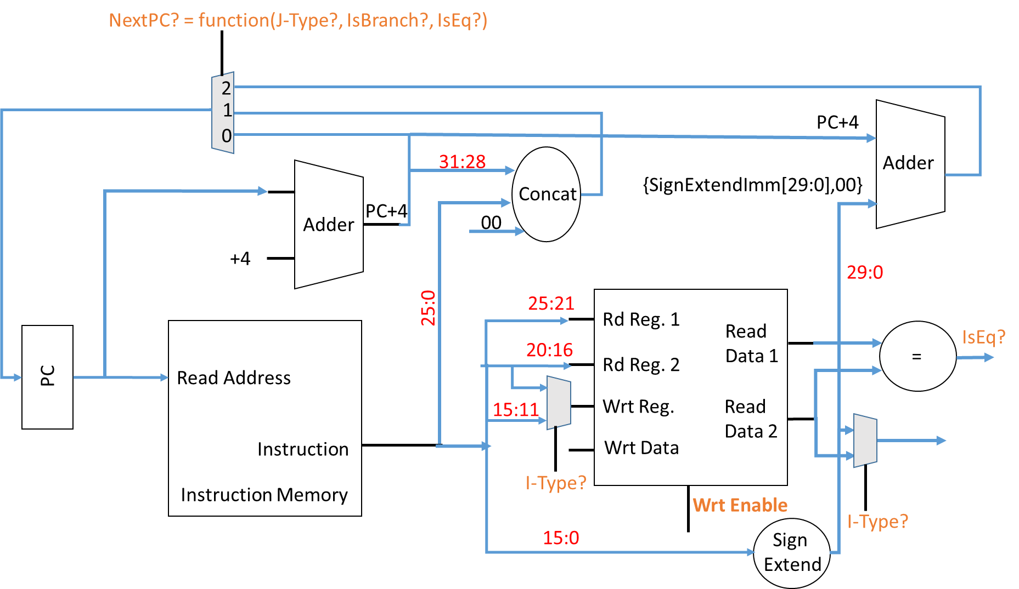
If (IsBranch? && isEQ?)
NextPC? = 2
else if (J-Type?)
NextPC? = 1
else
NextPC? = 0
In-Class Problem 3:
Write pseudo-code for NextPC?

Slide 27
Synchronous Implementation
Most digital circuits make use of a periodic “clock”
Flip-flop: basic component used in synchronous designs
Looks at In at every positive clock edge and sets Out = In
Holds the value of Out steady till next positive edge
Positive Edge
In
Out
FLIP-FLOP
Clock Period (seconds)
clock

Slide 28
Flip-flop Operation
Clock
In
Out
FLIP-FLOP
In
1
clock
Out
0
0
0

Slide 29
Synchronous Counter
32 bits
State is only updated at every positive clock edge
In
Out
Adder
32 bits
FLIP-FLOP
+1
clock
Clock
0
1
2
3
4
5

Slide 30
Synchronous Single-Cycle MIPS
Goal: A new instruction is fetched and executed in every clock period
For now let’s focus on the instruction fetch part of R-type instructions
PC register implemented using flip-flops
Adder
Adder
+4
+4
FLIP-FLOP
(PC)
PC
Read Address
Read Address
Instruction
Instruction
Instruction Memory
CLOCK
Instruction Memory

Slide 31
Fetch Stage Operation
Clock
PC register implemented using flip-flops
Adder
+4
PC
0
4
8
nextPC
4
8
12
nextPC
FLIP-FLOP
(PC)
Read Address
PC
Inst
Instruction
In every clock cycle, the PC is updated and the corresponding instruction is fetched from instruction memory
CLOCK
Instruction Memory

Slide 32
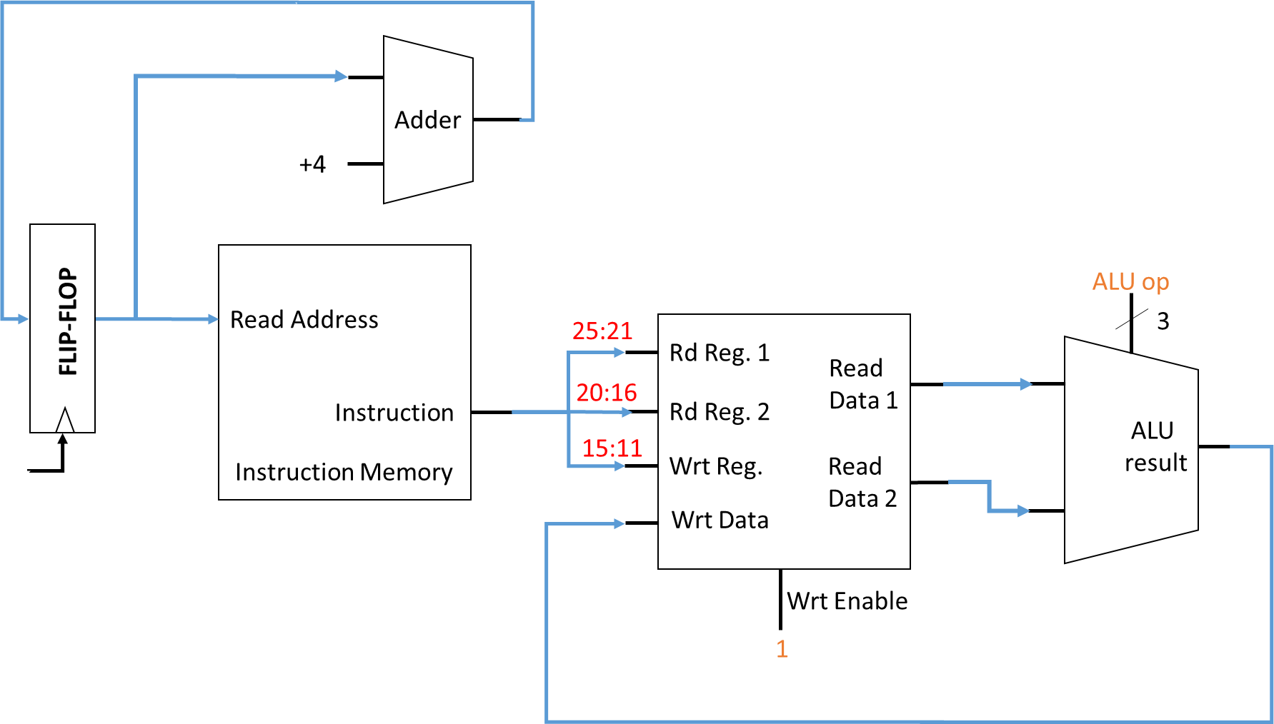
Execute/Write-Back Stage Operation
Goal: all updates to architectural state should occur at positive clock edges
PC (already done!)
Register file
Data memory (not relevant for R-type instructions)

Slide 33
0
00000
3
00001
12
00010
4
Adder
.
00011
+4
1
.
Decoder
9
11111
Wrt Enable
4
ALU op
0
add $1, $2, $3
FLIP-FLOP
(PC)
Read Address
3
25:21
Rd Reg. 1
Read
Data 1
3
20:16
Instruction
Rd Reg. 2
15
ALU
result
15:11
12
Instruction Memory
Wrt Reg.
Read
Data 2
Wrt Data
What’s wrong?
15
FLIP-FLOP

Slide 34

0
00000
3
00001
12
00010
4
Adder
.
00011
1
15
+4
1
.
Decoder
9
11111
Wrt Enable
4
add $0, $1, $2
1
ALU op
0
add $1, $2, $3
FLIP-FLOP
(PC)
Read Address
$0
3
$1
Rd Reg. 1
Read
Data 1
3
$1
$2
Instruction
Rd Reg. 2
15
$3
ALU
result
$2
$3
Instruction Memory
Wrt Reg.
Read
Data 2
12
Wrt Data
15
FLIP-FLOP

Slide 35
0
00000
3
00001
12
00010
4
Adder
.
00011
1
15
+4
1
.
Decoder
9
11111
Wrt Enable
4
add $3, $1, $2
1
ALU op
0
add $1, $2, $3
FLIP-FLOP
(PC)
Read Address
$3
3
$1
Rd Reg. 1
15
Read
Data 1
3
$1
$2
Instruction
Rd Reg. 2
15
$3
ALU
result
$2
$3
Instruction Memory
Wrt Reg.
Read
Data 2
12
Wrt Data
Simultaneous R/W request to the same register -> Write before Read
15
FLIP-FLOP

Slide 36
Synchronous Counter Clock Period
32 bits
Assume each addition takes 1 ns. What is the minimum clock period?
6
In
Out
Adder
32 bits
5
+1
FLIP-FLOP
clock
5
1 ns
6
Clock
Period > 1ns

Slide 37
What is the clock period of the single cycle MIPS?
Assume each block has a delay of 1 ns
1 ns
Adder
2 ns
+4
Decoder
0 ns
Wrt Enable
ALU op
FLIP-FLOP
(PC)
Read Address
3
0 ns
Rd Reg. 1
Read
Data 1
2 ns
Instruction
Rd Reg. 2
3 ns
1 ns
0 ns
ALU
result
Instruction Memory
Wrt Reg.
Read
Data 2
2 ns
Wrt Data
Minimum Period = 3 ns
0 ns
FLIP-FLOP

